Slide 1
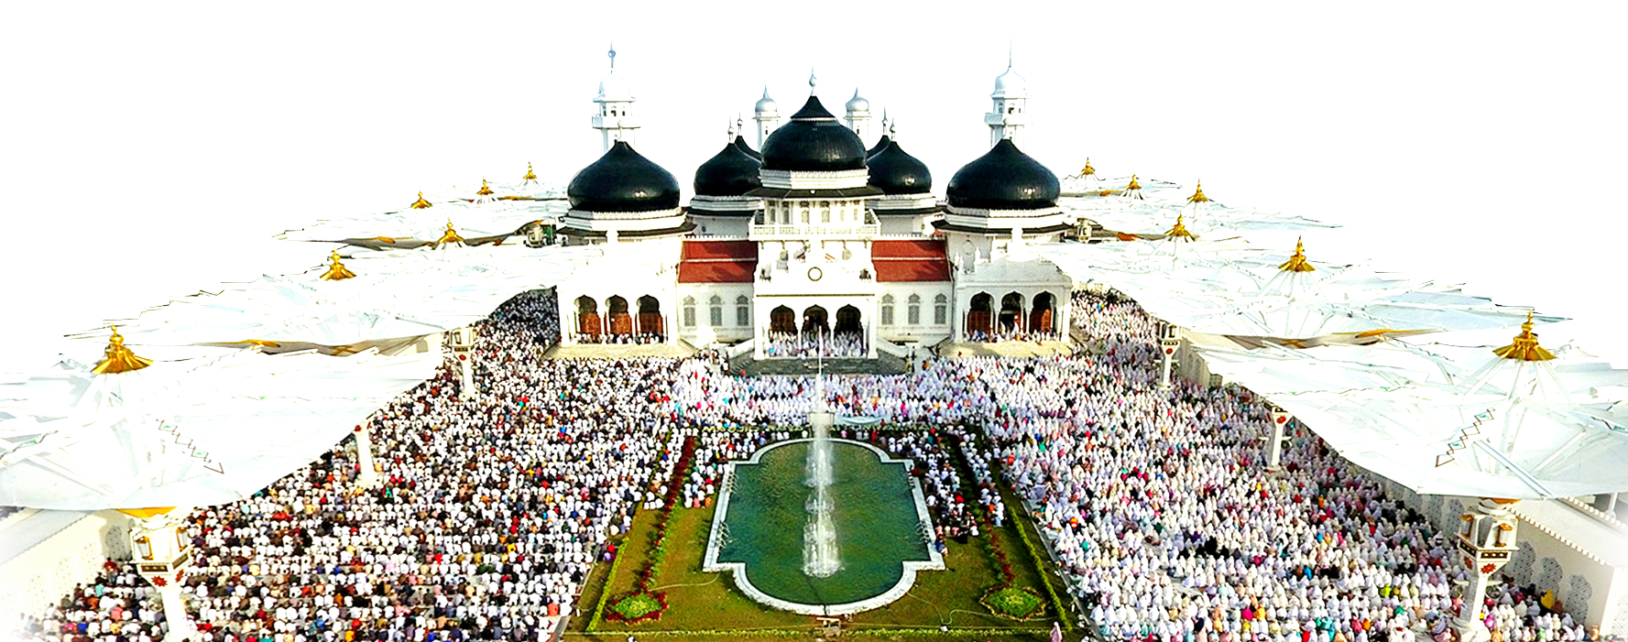
LOCALIZING SDGs TO FOSTER INCLUSIVENESS IN BANDA ACEH
THE 6TH ASIA PACIFIC FORUM ON SUSTAINABLE DEVELOPMENT (APFSD)
“Promoting Enabling Environment for Inclusiveness by Localizing SDGs”
March 28, 2019 UNCC Meeting Room, Bangkok
By The City Director of Banda Aceh City

Slide 2
1
Banda Aceh City Profile
Outline
2
SDGs Achievement Index in Banda Aceh
3
Inclusive approach planning
4
SDGs Oriented Programs

Slide 3
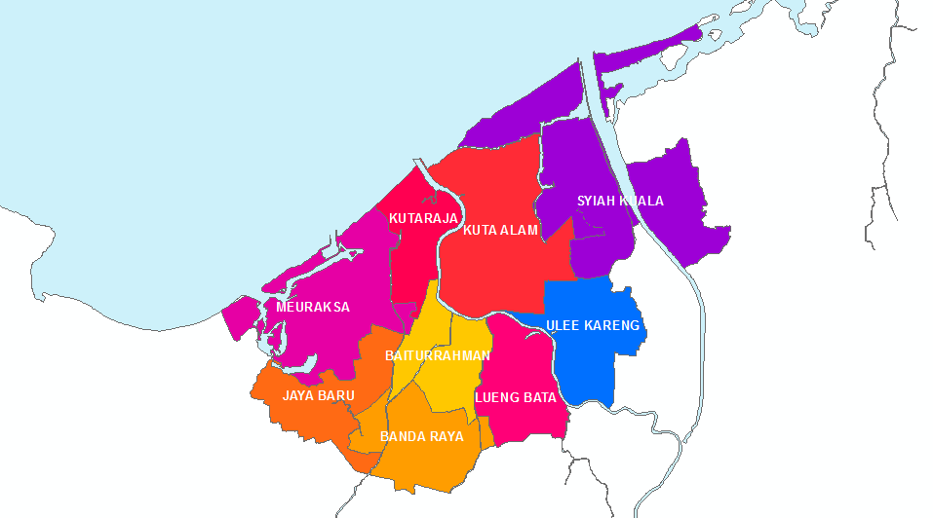
Banda Aceh City
Area:
61 Km²
Elevation:
0,8 m Above sea level
9 Districts
90 Villages
Population:
259.913 Inhabitants
PARAMETER | 2004 (Pre Tsunami) | 2018
Economic Growth (%) | 4.81 | 3.04
Inflation (%) | 6.97 | 4.86
Local Own-Source Revenue (USD) | 672,899.8 | 18.27 M
Gross Domestic Product (GDP) per Capita (USD) | 538.3 | 4579.9
Poverty | 8.89 | 7.44
Unemployment (%) | 10.10 | 7.75
Human Development Index | 74.04 | 83.95

Slide 4
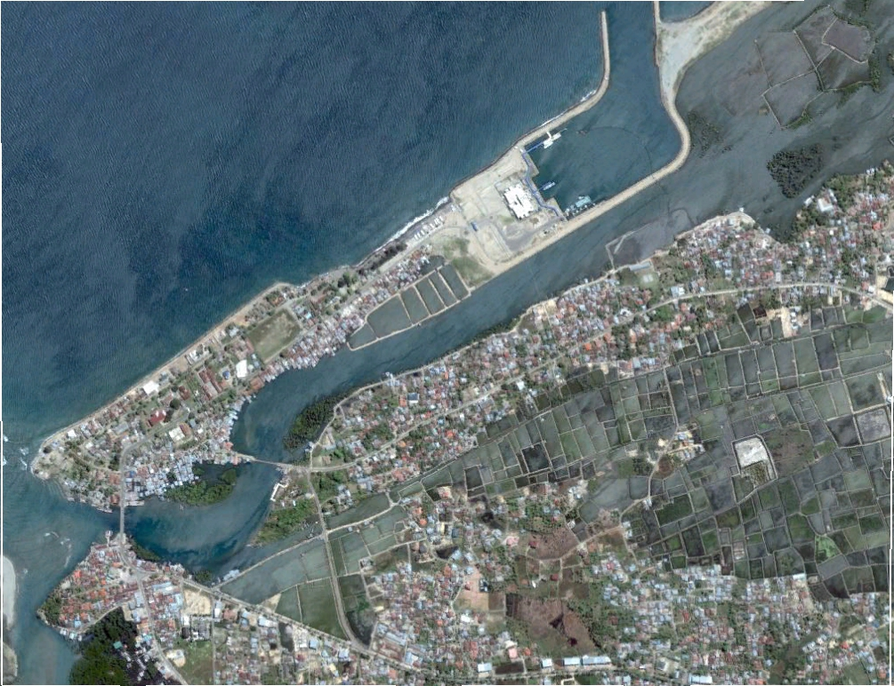
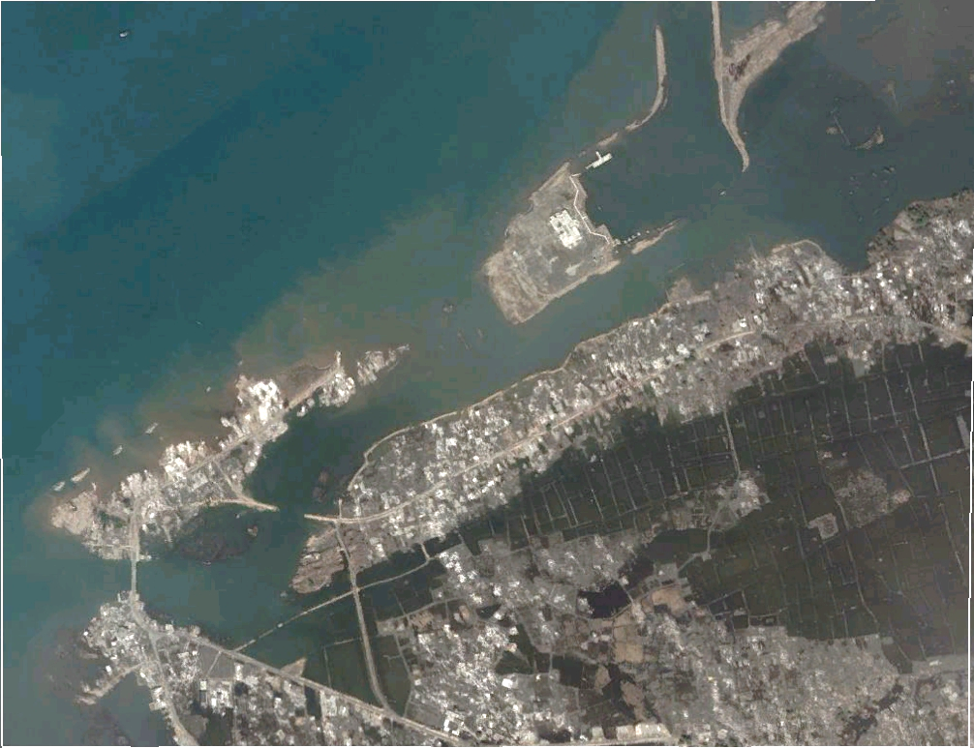
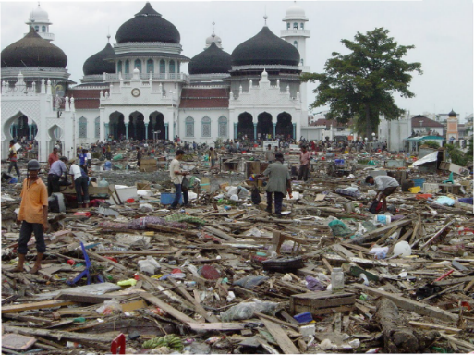
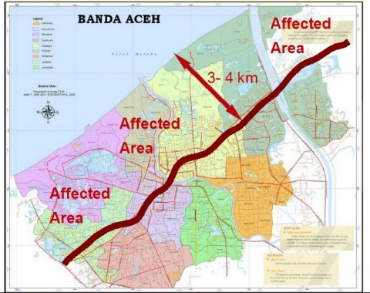
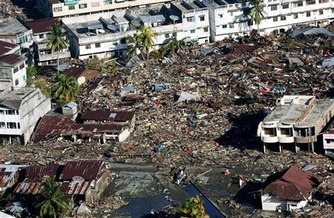
The Destruction Figure in Banda Aceh
City of
Banda Aceh
On December 26, 2004 the earthquake followed by Tsunami destroyed 1/3 of city infrastructure
Before
Tsunami
After
Tsunami
61,065 missing/died
21,751 houses
169 education facilities
25 health facilities
302 km roads
63 Government offices
9 market buildings

Slide 5
City of
Banda Aceh
Infrastructure Profile
86%
Clean Water
Coverage
99,27%
91,72%
Livable housing
Household with
good sanitation
13,2%
88%
Public Green
Open space
Waste collection
coverage

Slide 6
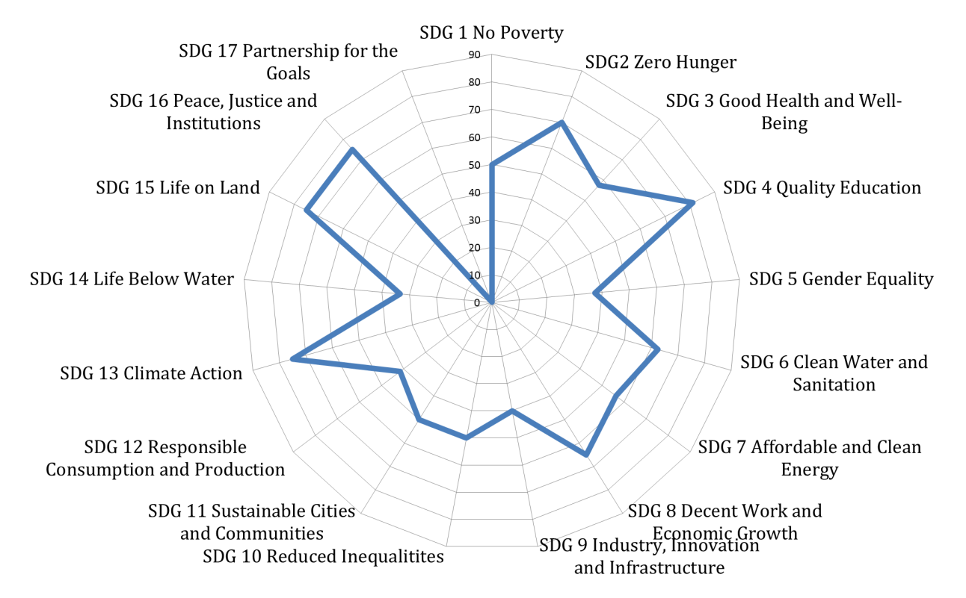
City of
Banda Aceh
SGDs Index
BANDA ACEH BIGGEST ISSUES IN SDG
Gender Equality (lack of women representative in city parliament)
Industry, Innovation and Infrastructure (low development of innovation sector)
Responsible Consumption and Production (lack of waste recycle and waste water treatment)
Life below water (lack of pollution treatment)
Partnership for the goals (lack data provision)
Average 55%
GENDER EQUALITY
66% WOMEN CIVIL SERVANTS
12% WOMEN TOP OFFICIALS
39% MIDDLE OFFICIAL
REGULATIONS TO SUPPORT SDG INCLUSIVENESS
Mayor Regulation No 52 Year 2009 on The General Implementation Guideline of Musrena (Development Planning Forum for Women)
Mayor Regulation No 1 Year 2019 on The Fulfillment of Right for People With Disabilities to Decent Job
Mayor Regulation No 14 Year 2017 on The Inclusive Development Planning
Mayor Regulation No 14 Year 2018 on The Development of Banda Aceh City Towards Children-Friendly City
Mayor Decision No 265 Year 2016 on The Assignment of School/Madrasa Implementing Inclusive Education Model
Mayor Regulation No 18 Year 2018 on Gender Responsive Planning and Budgeting

Slide 7
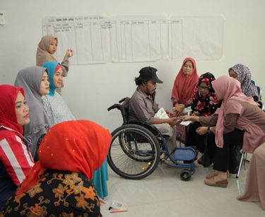
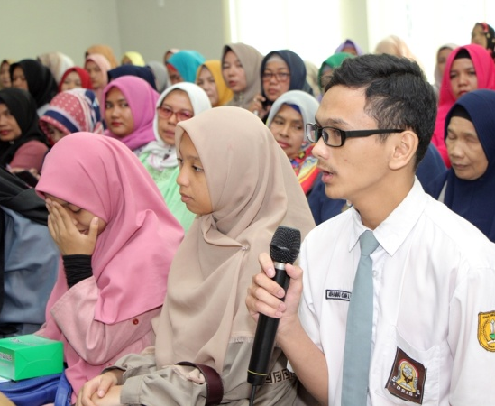
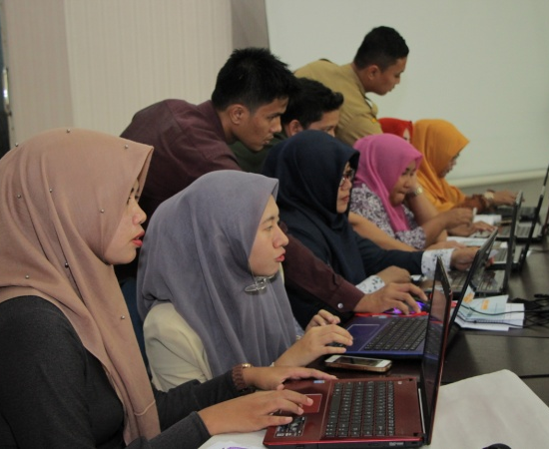
City of
Banda Aceh
Inclusive Planning Approach
FOCUS ON WOMEN NEEDS
MUSRENA – DEVELOPMENT PLANNING FORUM FOR WOMEN
Since 2007, Banda Aceh has conducted Musrena (Development Planning Forum for Women), a special forum for women to collect women aspirations and give opportunity for women to involve in the development process.
Musrena also involves children group and disabled group
Starting from 2017, Banda Aceh develop an online application E-Musrenbang, which integrate proposal from Musrena and Musrenbang.
INVOLVE DISABILITY GROUPS
ACCOMMODATE CHILDREN FORUM
EASY AND TRANSPARANT

Slide 8
City of
Banda Aceh
The Impact Musrena on
Development Program

Slide 9
Other SDGs
Oriented
Programs

Slide 10
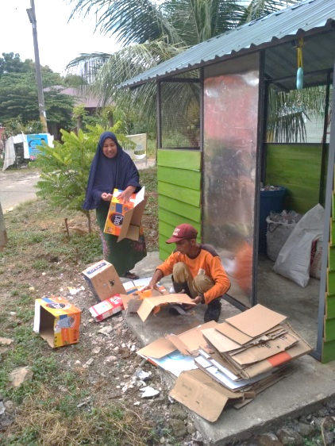
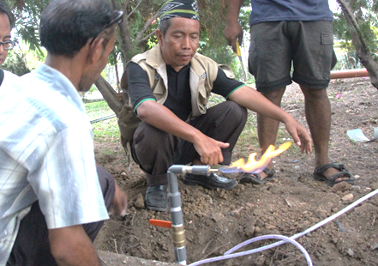
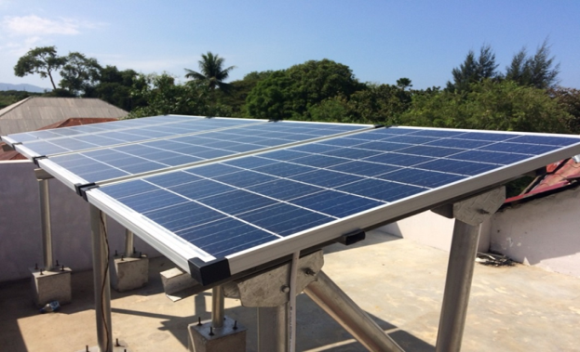
Climate Change Programs
City of
Banda Aceh
Green City
 | 24,99% Open Space Public 13,2% Private 11,79% Tibang and Peulanggahan City Forest Waste to Energy Low Carbon Model Town (LCMT) Solar panel Partnership with private sector Waste Collecting Point (WCP)
Tibang City Forest
Methane Utilization
Waste Collecting
Point
Rooftop solar panel

Slide 11
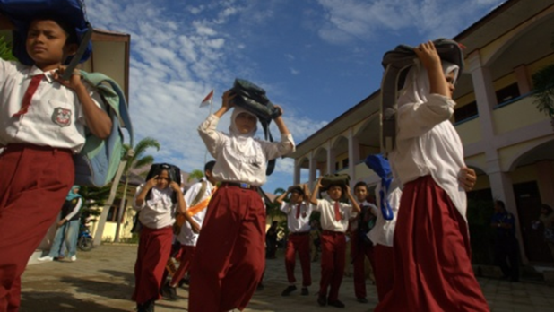
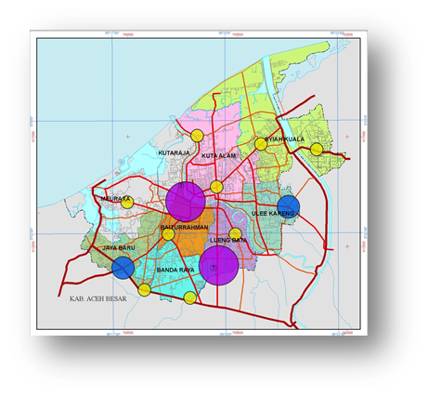
City of
Banda Aceh
City Resilience Programs
Disaster Risk Reduction
 | Establish a Regional Disaster Management Agency Spatial Planning (2009-2029) and Medium Term Development Plan (2012-2017) Contingency planning and micro zone Establish resilient villages and Disaster Mitigation Forum

Slide 12
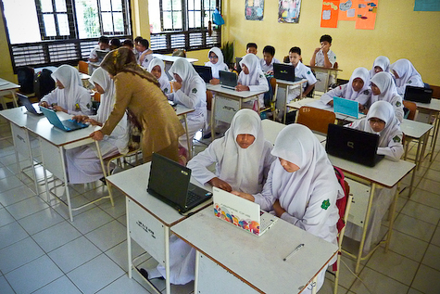
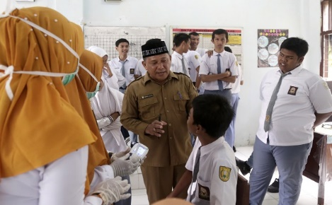
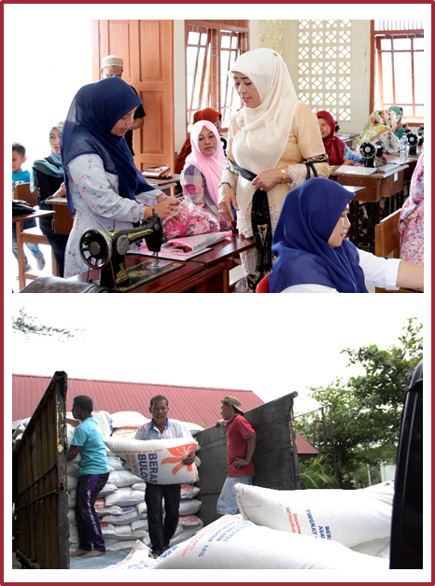
City of
Banda Aceh
Economic Programs
Reduce Poverty and Unemployment
Poverty card Identify the poor by name by address
Trainings for youth, unemployment, women and disability group
Zakat as the source of support for the poor
Education Programs
Improve Education Quality
76% of schools in Banda Aceh have reach National Standard (SNP)
Inclusive School 6 kindergarten 20 elementary schools 9 junior school 15 school for student with disabilities 128 certified teacher

Slide 13
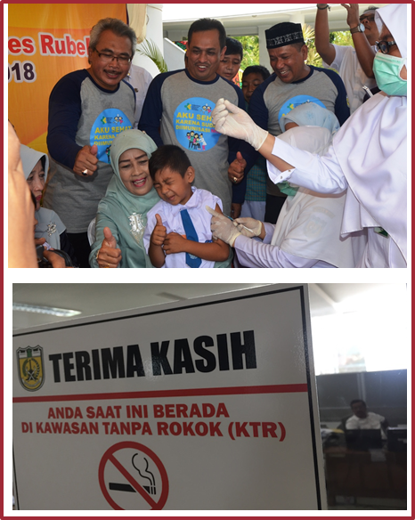
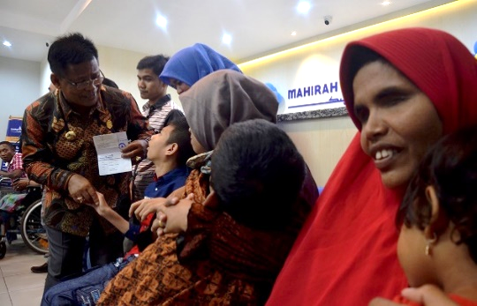
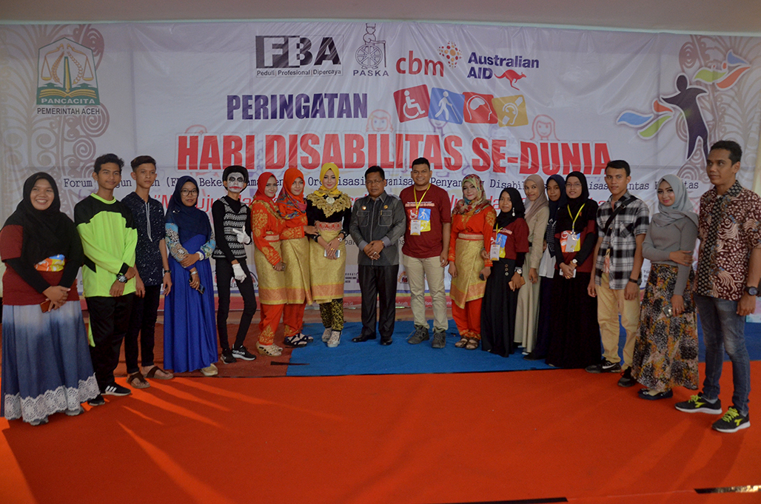
City of
Banda Aceh
Programs For Disability Group
Inclusive City
Education and trainings
Partnership with NGOs
Economic and daily needs support
Involvement in planning and development processes Health services
Health
Services
Non Smoking Area
Regional Regulation No 5 Year 2016
Quality Health Services
Free health facility JKA Program (Aceh Health Insurance Program)
Health facility with ISO standard

Slide 14
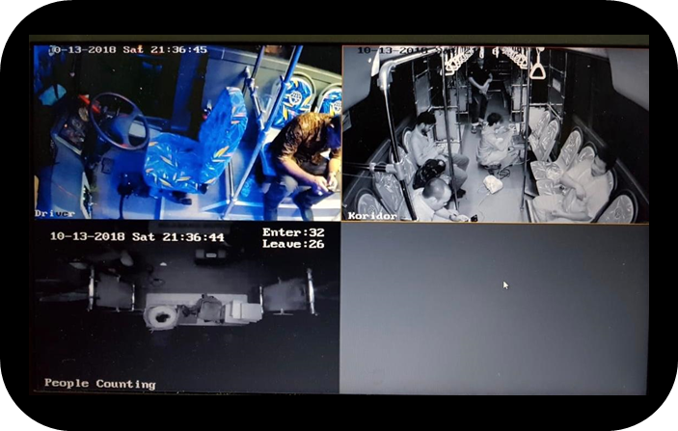
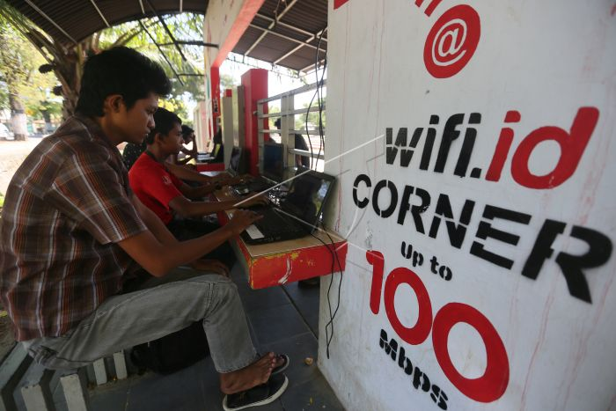
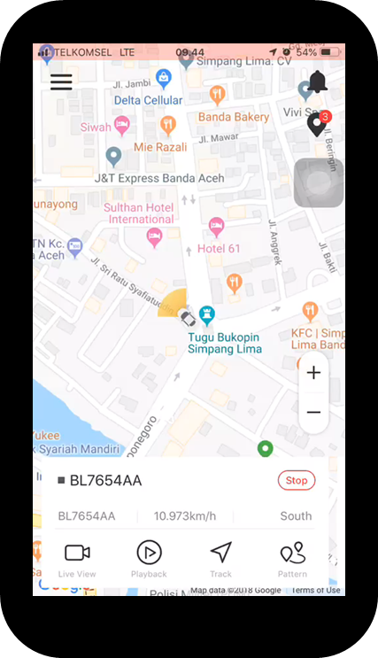
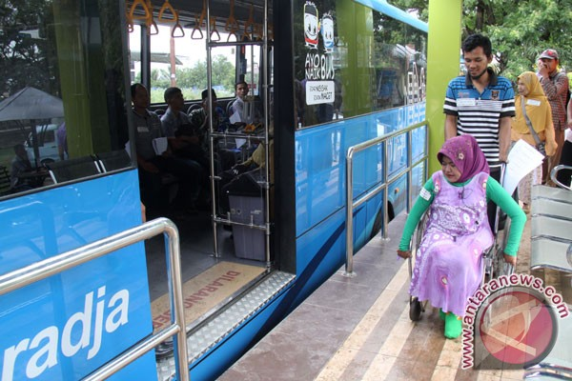
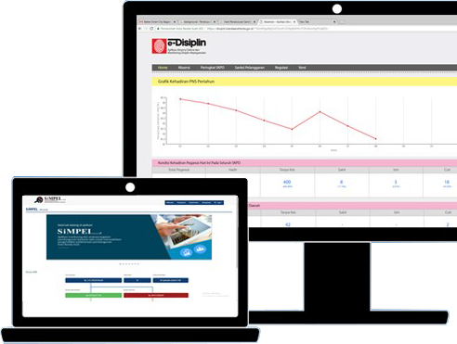
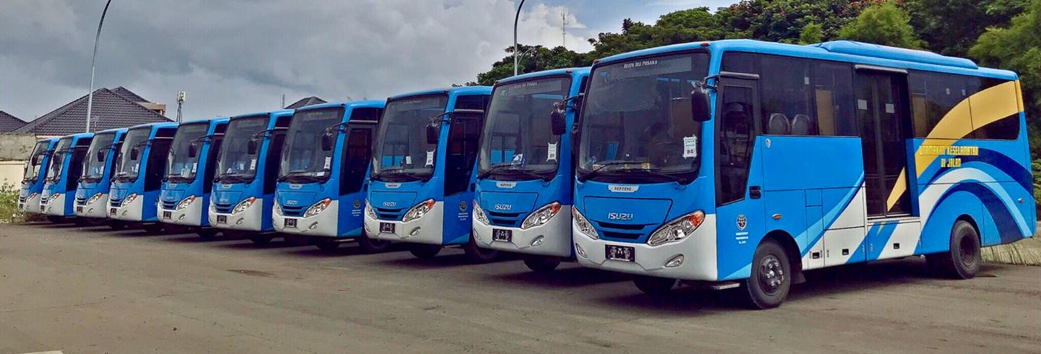
Smart Transportation
BRT Transkutaraja
City of
Banda Aceh
>60% carbon emission
CCTV MONITORING SYSTEM
Information &
Technology
4 of 5 population has personal vehicle
GPS TRACKING SYSTEM
Open Data
122 applications
DILO (Digital Innovative Lounge) to accommodate entrepreneur creativities
E-Perfomance (E-Kinerja) Online Permits system Free Wifi (In public space)
77% trip by motorcylce
INCLUSIVE ACCESS
11% trip by personal car
4 Corridors
Currently 40 units of 90 busses planned

Slide 15
City of
Banda Aceh
Challenge To Achieve SDG
IT for SDG
Multi stakeholder approach
Coordination and planning integration
Alternative financing
Capacity building
Award system

Slide 16
Development Achievements 2018
City of
Banda Aceh
Development Indicator | 2004 (Banda Aceh Before Tsunami) | 2005 (Banda Aceh After Tsunami) | 2018
 |  |  | Banda Aceh | Aceh Province | National
Economic Growth (%) | 4.81 | 3.35 | 3.04 | 4.61 | 5.19
Inflation (%) | 6.97 | 41.11 | 4.86 | 4.25 | 3.6
Local Own-source Revenue (USD) | 672,899.8 | 403,739.9 | 18.27 M | 1629.12 M | 122,963 M
GDP per Capita (USD) | 538.3 | 821.87 | 4579.9 | 2002.4 | 3675.4
Human Development Index | 74.04 | 74.68 | 83.95 | 70.60 | 70.81
Population | 239,000 | 177,881 | 259,000 | 5.1 M | 261.9 M

Slide 17
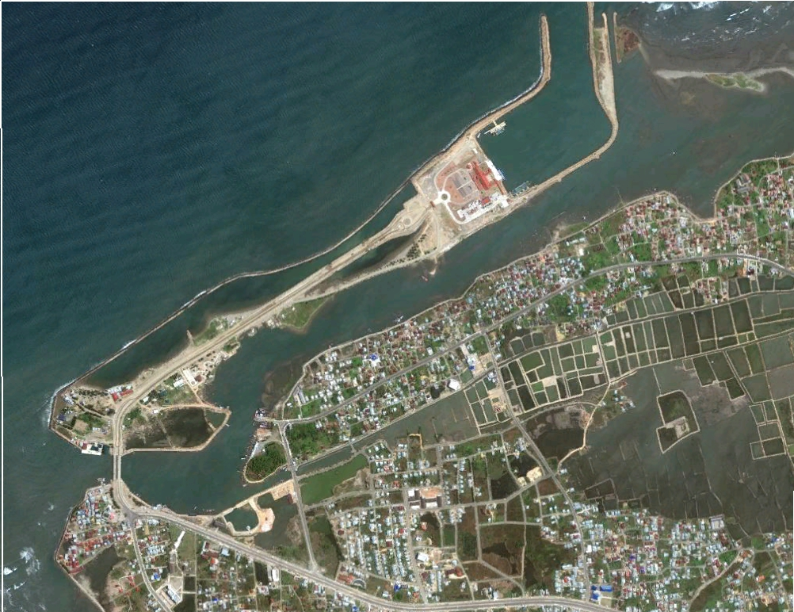
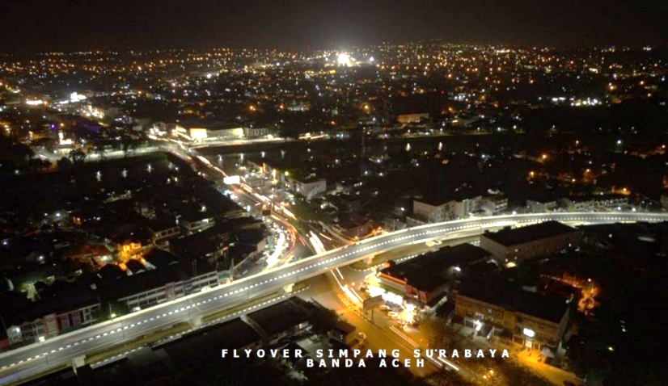
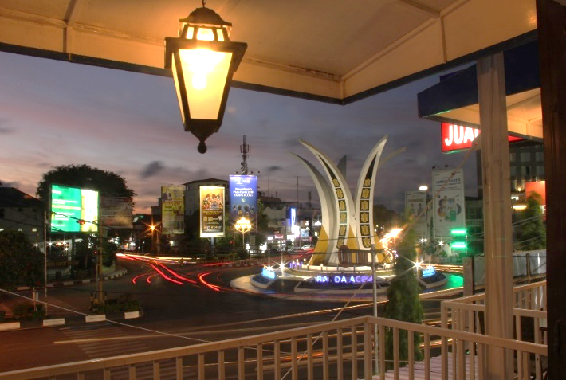
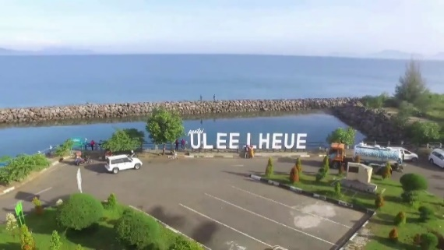
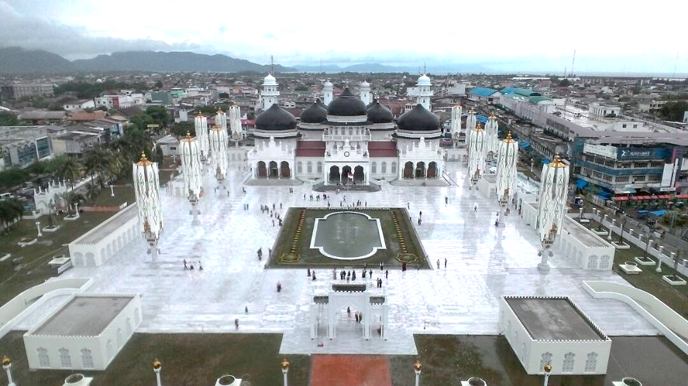
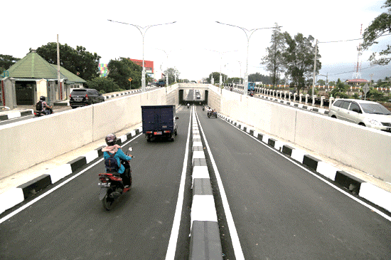
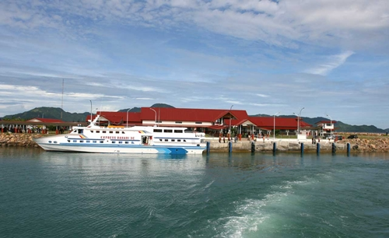
Coastal Area 2009
City of
Banda Aceh
Flyover at Simpang Surabaya
Landmark Tugu Simpang Lima
Tourism Infrastructure
Baiturrahman Mosque
Ulee Lheu Port
Underpass
Infrastructures
Development

Slide 18
