Slide 1
6th Asia Pacific Forum On Sustainable Development (APFSD)
Inclusive Climate Action through Seberang Perai Strategic Plan
2018-2022
Dato’ Sr Haji Rozali Bin Haji Mohamud
President
Seberang Perai Municipal Council

Slide 2
HAS YOUR CITY ADDRESSED INCLUSIVE ASPECTS IN THE CLIMATE ACTION PLAN
Seberang Perai Climate Action Plan was formulated with various series of Engagement with stakeholders.
Inclusiveness was incorporated in Seberang Perai vision, “Seberang Perai Resilient, inclusive, green, competitive and technolgy driven smart city”
Corporate Guiding Principle - “Seberang Perai Is City For All” focusing on Improve Governance, Accessibility and Mobility, No One Should Be Excluded, Universal Design and Gender Responsive Participatory Budgeting

Slide 3
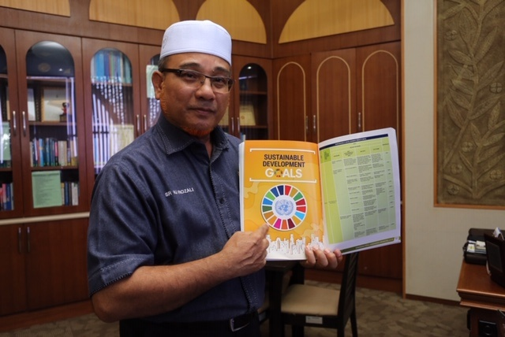
Dato’ Sr Hj Rozali Bin Hj Mohamud shows the strategic plan detailed in the
Corporate Priorities 2019 that is in line with Sustainable Development Goals (SDGs)

Slide 4
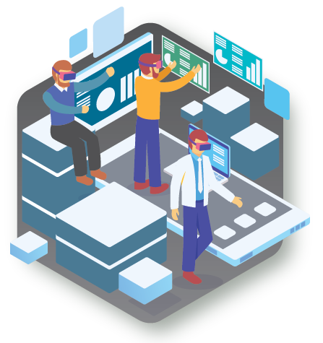
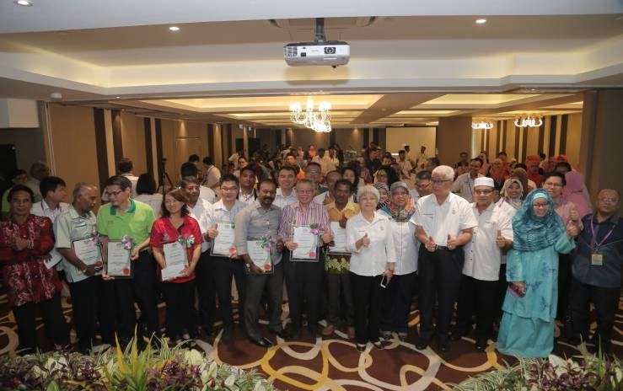
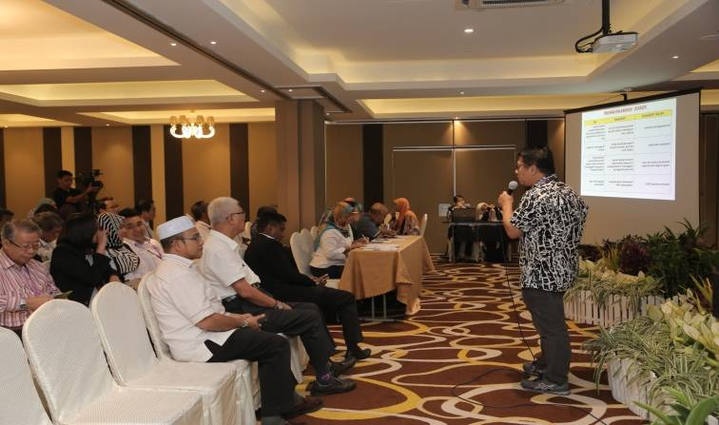
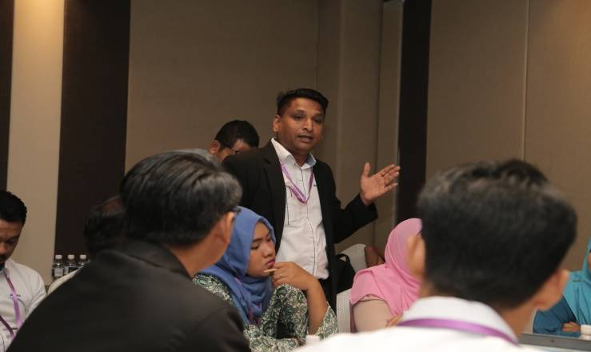
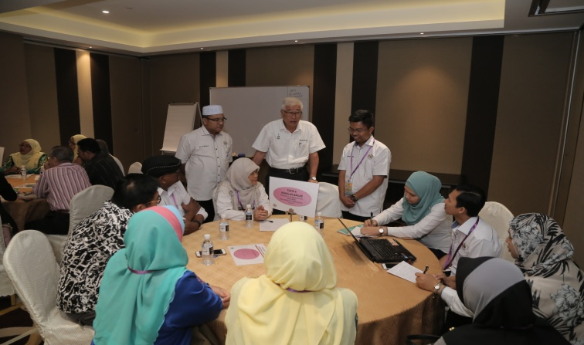
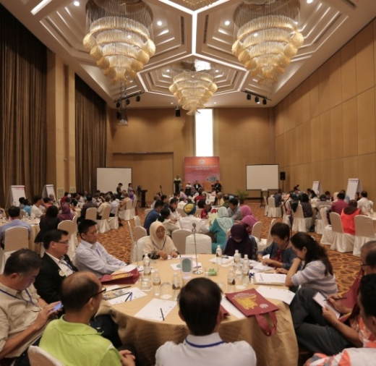
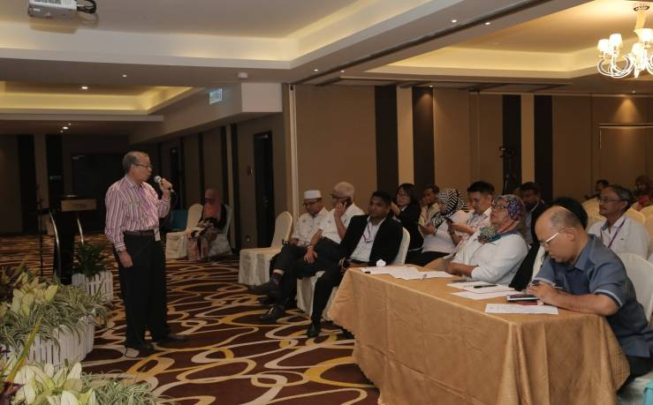
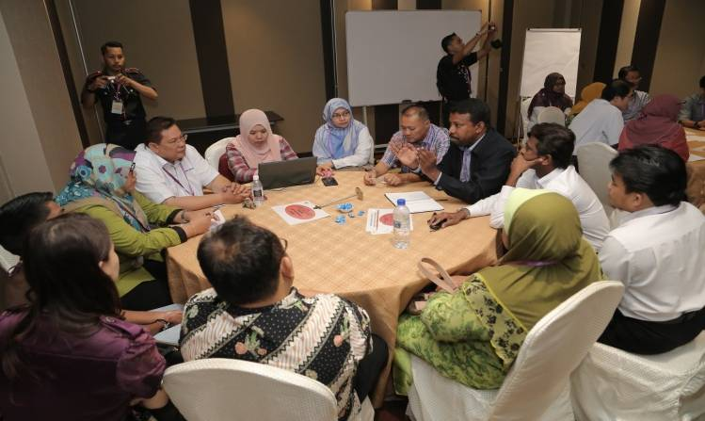
Town hall Sessions
Dialogue
Budget

Slide 5
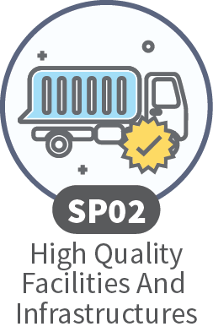
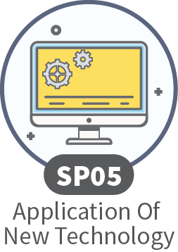
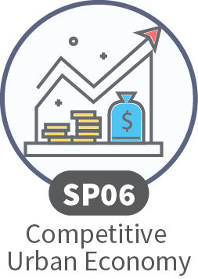
Respondents priority level of MPSP services
YEAR: 2019
24.4%
17.9%
16.1%
15.2%
10.7%
7.3%
3.8%
2.6%
1.1%
0.9%

Slide 6
Seberang Perai Corporate Priorities 2019
has adopted the
PEOPLE-CENTRIC APPROACH
Guiding Principle
“Seberang Perai is a City for All”

Slide 7
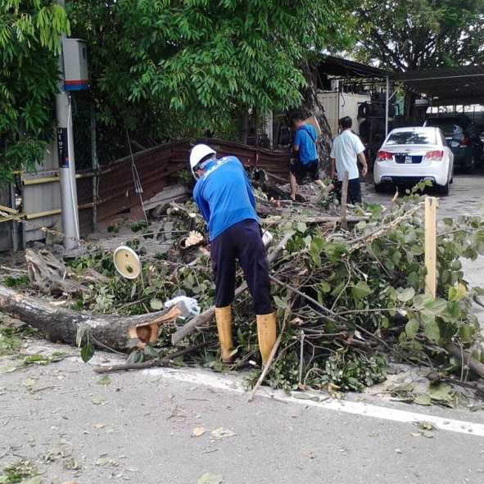
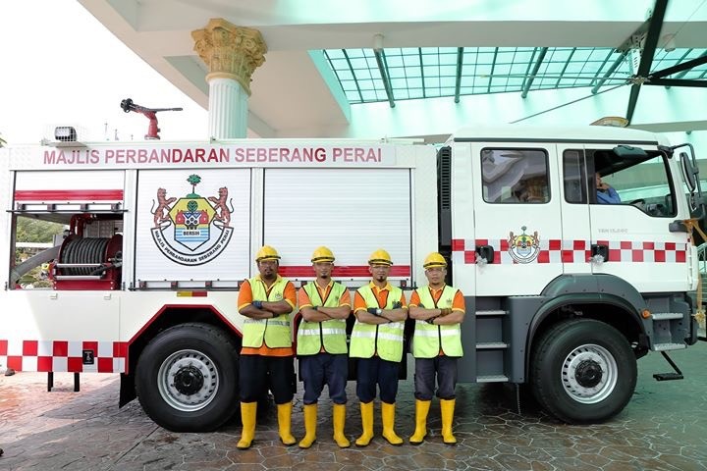
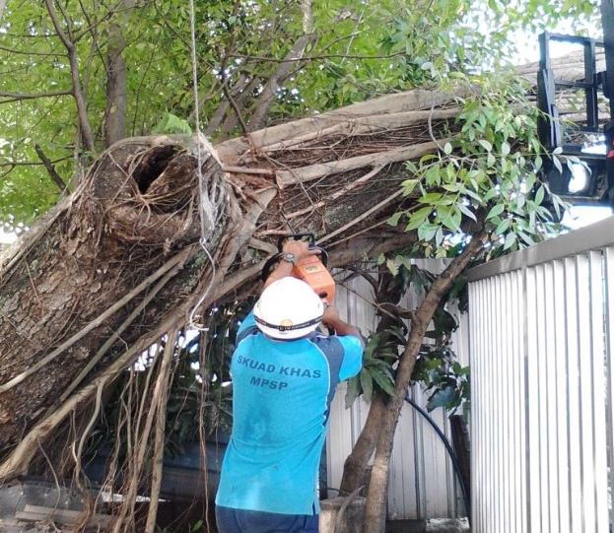
Security and Safety
Crisis Management Department
Dedicated team to response during disaster and crisis. This team is available for 24 hours everyday throughout the year. Equipped with multiple vehicles and equipments to tackle almost any sort of municipal crisis.
Seberang Perai Disaster Management Plan highlight the role of every members of the community.
Engagement and partnerships with the stakeholders are the key factors in building a resilient Seberang Perai
168 skill workers work in shift to enhance the preparedness in dealing with disaster and crisis.
This workers have been given adequate training regarding disaster management and responses.

Slide 8
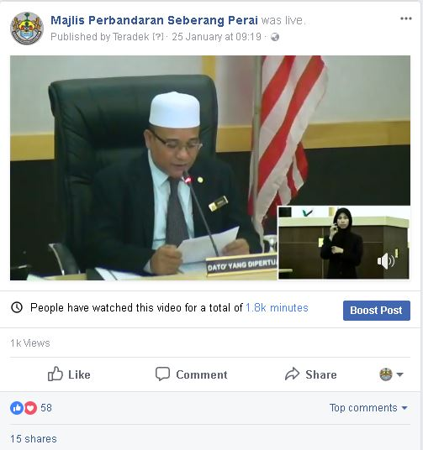
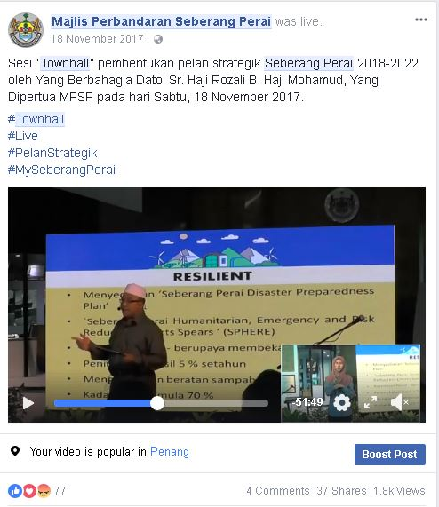
Using Sign Language Interpreter And Live Streaming

Slide 9
Customer Friendly Day
It was Held since 2018 for every three (3) months.
Involved various departments, focus on licensing issues, assist group B40 to start business and settle municipal offences.
The latest events was on 21 March 2019, with theme “Anda Perlu Kami Bantu” that specialize on:-
i. Issues on temporary permit or business building.
ii. Issues for business licenses.
iii. Consultation on planning
a. Issues of permission of planning (Form C1) immediately after
approval.
b. Application for development through Dealing With
Construction Permit (DCP)
iv. Safer City Exhibition and guidelines

Slide 10
Customer Friendly Day

Slide 11
WHAT ARE THE BENEFIT EVIDENCES OF INCLUSIVE CLIMATE ACTION

Slide 12
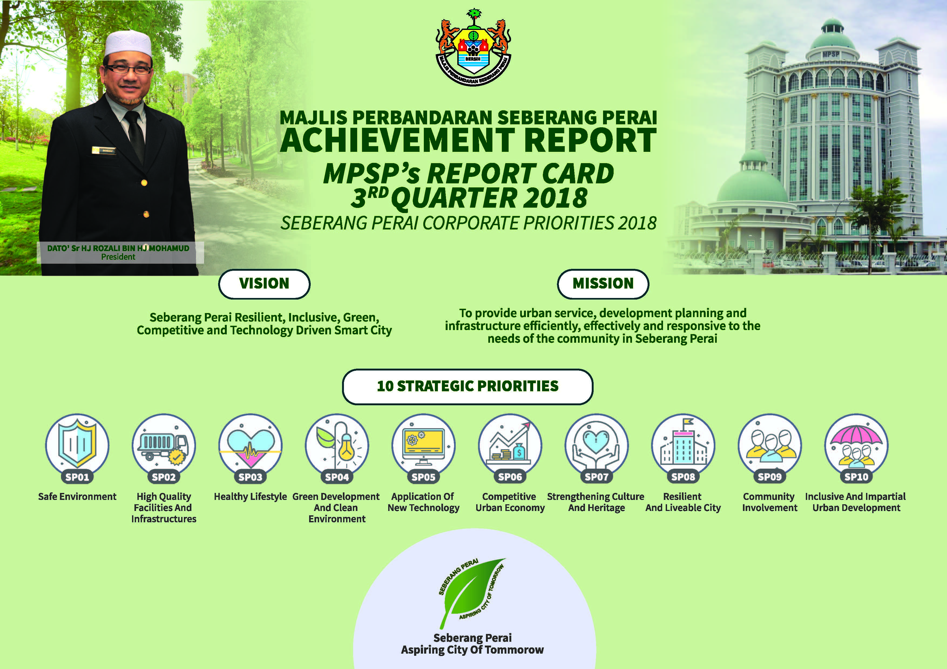
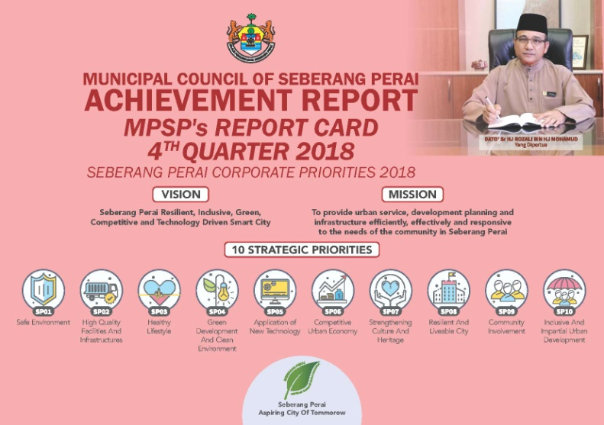
REPORT CARDS- ACHIEVEMENT
Performance Base Management System produced Quarterly Report Card reported the status and progress of all programs and activities under the Seberang Perai Strategic Plan 2018 – 2022. Netizen and civil society can express their views and comments.

Slide 14
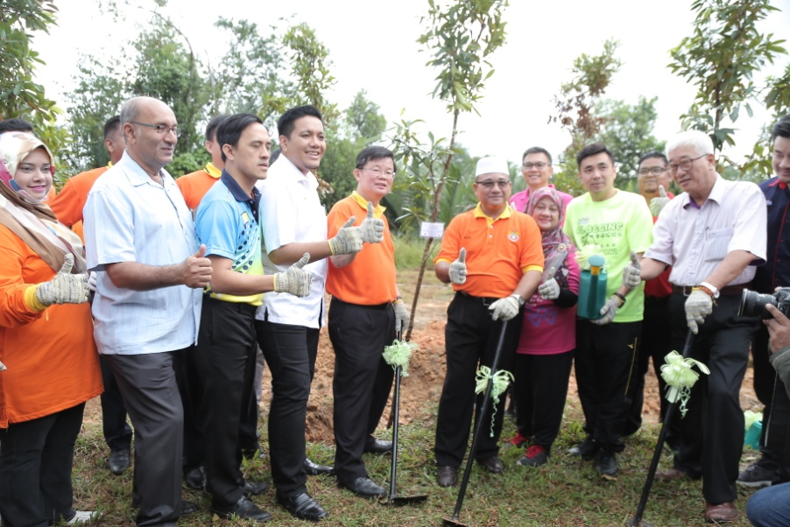
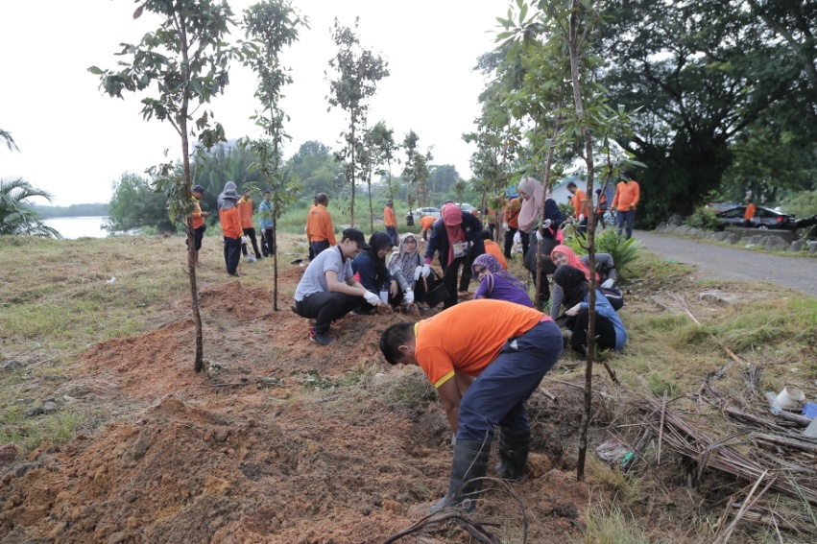
Tree Planting Events
Seberang Perai Municipal Council organizes annual largest tree planting events in conjunction with the National Independence Day.
It is a collaboration efforts between council, private sectors, NGOs, schools and higher institution.
Trees are important for carbon sequestration and release of oxygen. Our aim is to reduce current carbon capacity from 8ton CO2e per person per year to 4ton CO2e in year 2022.

Slide 15
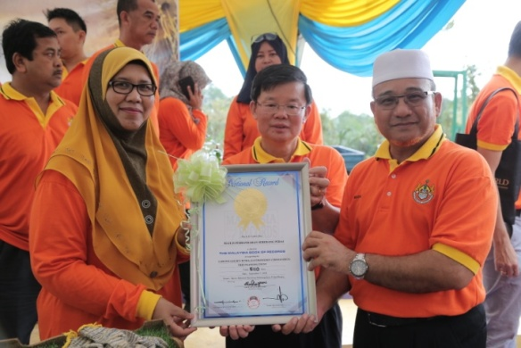
Tree Planting Events
In 2017, 3,000 Tecoma trees (Tabebuia sp.) were planted in 13 locations in Seberang Perai. This effort earned an entry in the Malaysia Book of Records (MBR) for the largest Tecoma tree planting event in the country.
On 7 September 2018, again we managed to enter the Malaysia Book of Records and beating the previous record by planting 5,110 Golden Penda trees in 45 locations in Seberang Perai.

Slide 16
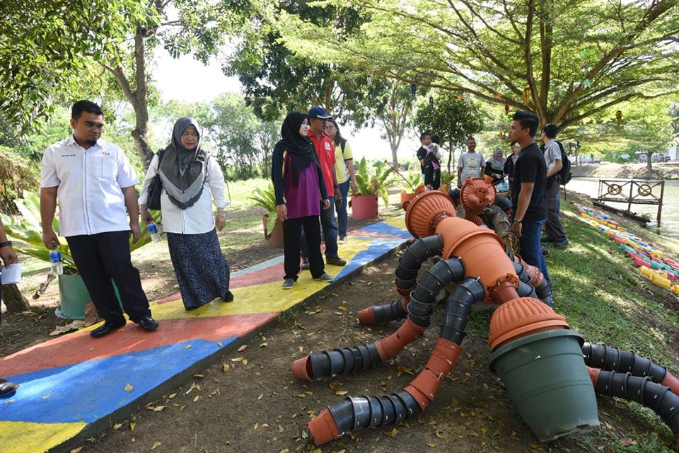
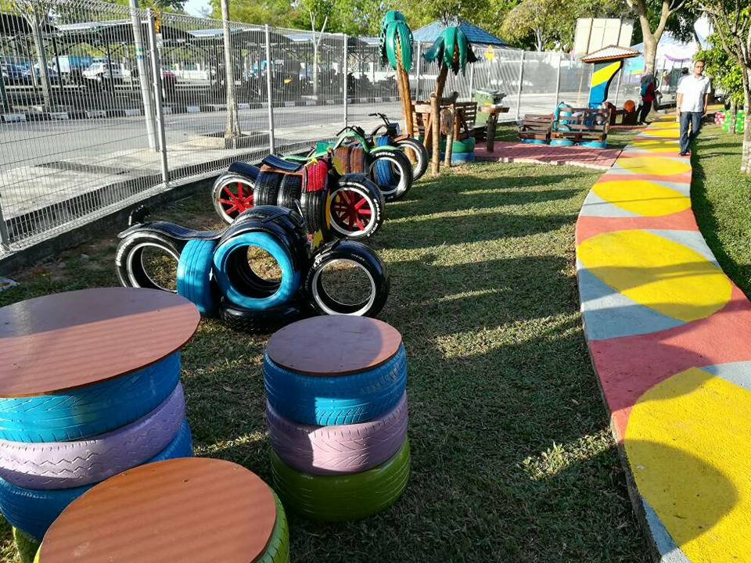
Upcycle Park
Seberang Perai Municipal Council upgraded a retention pond into an upcycle park. Decoration and components used in the upcycle park are waste materials creatively converted to upcycles and installed in the parks.
It was given the recognition for its uniqueness and has made its way into the Malaysia Book of Records as the first “First Organisation To Develop Upcycle Park” on 7 September 2018

Slide 17
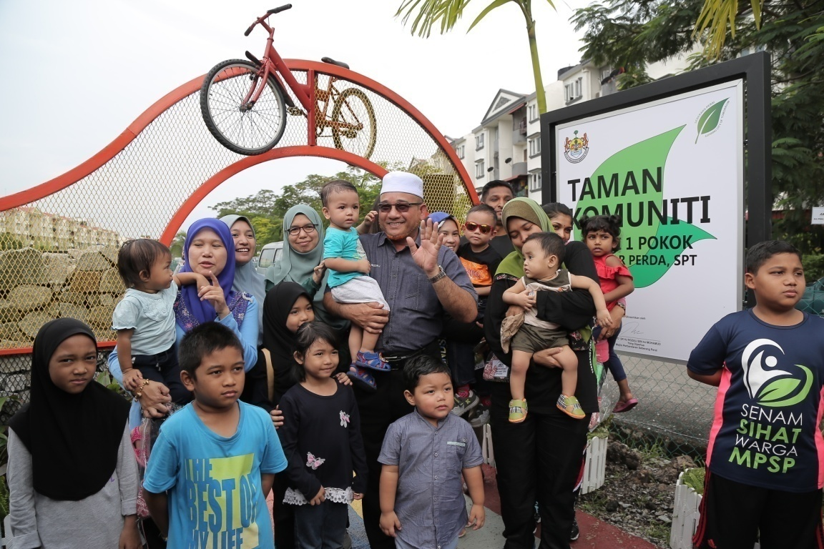
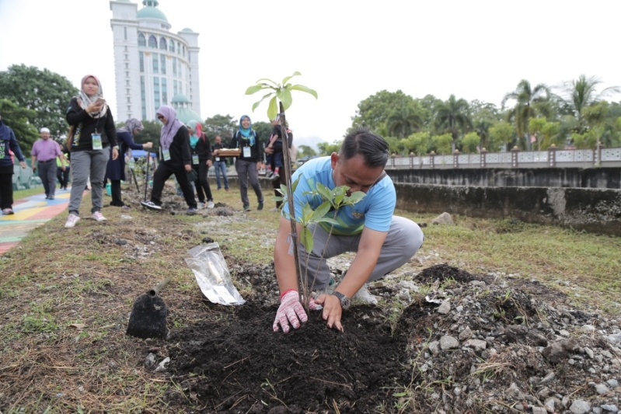
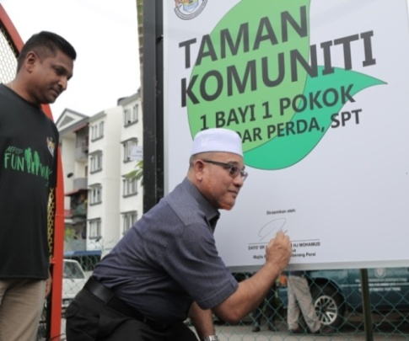
Community Park
Initiated community park by planting tree for every baby born in the area (1 baby 1 tree).
1 Baby 1 Tree Programme is intended to launch a drive that will empower the children to learn more and appreciate the environment as well as learn how to care the natural resources and surroundings, while protecting them.
Some parks are upgraded and turned into a park featuring attractive, beautiful artworks and landscaping which are suitable for photography enthusiast.

Slide 18
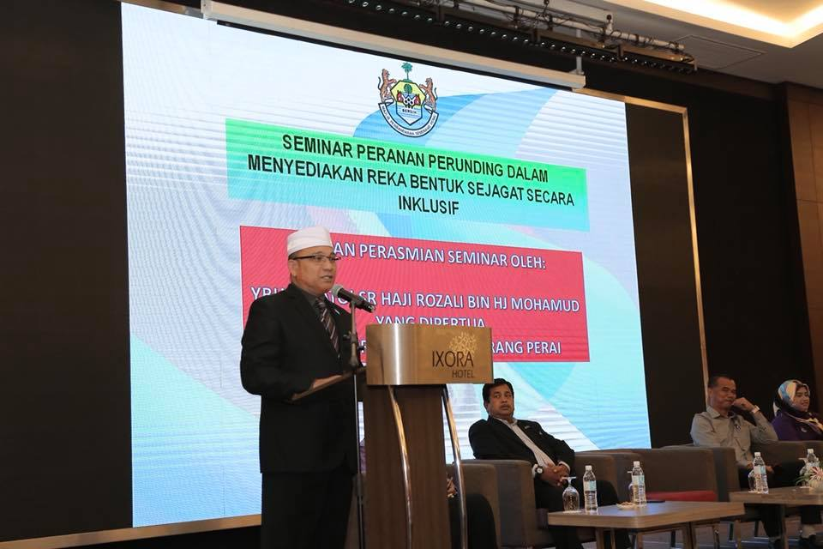
MPSP produced its own guideline on Universal Design titled “Panduan Ringkas Reka bentuk Sejagat”.
Principal Submitting Person (PSP) are required to follow the guideline as it is a fundamental condition of good design that meets the needs of all people.
MPSP is also conducting trainings to all PSP practitioners and public on design and composition of an environment which includes any building, product, or service in particular environment so that it can be accessed, understood and used to the greatest extent possible by all people regardless of their age, size, ability or disability.

Slide 19
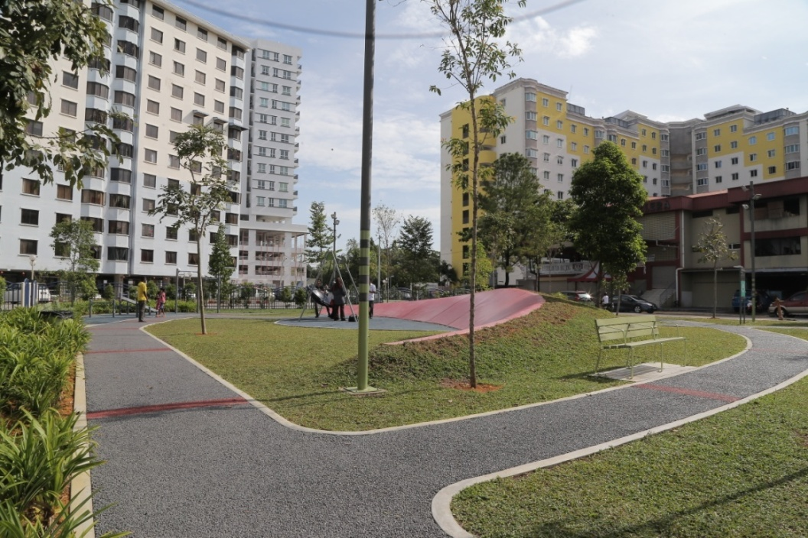
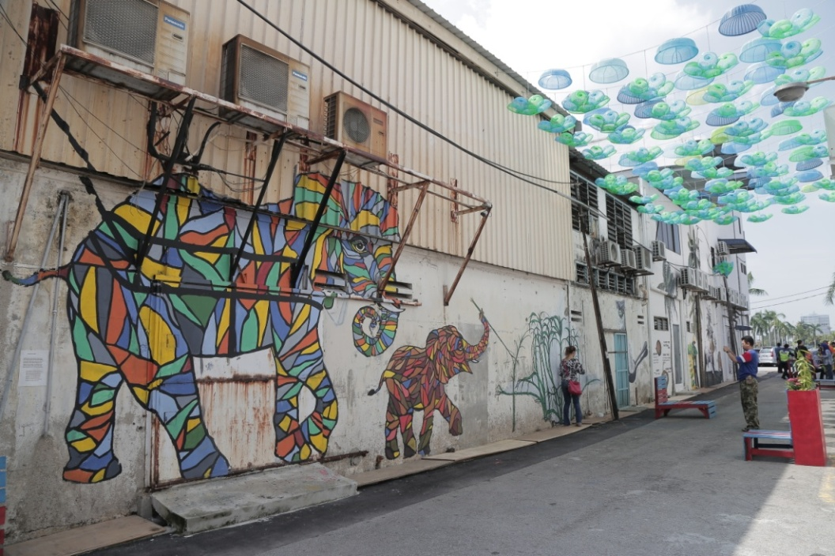
Open Spaces And Recreational Areas
Seberang Perai Municipal Council also created and established many public spaces or parks to accommodate sport and exercise activities, photo wedding shoots, wedding ceremonies, food carnivals etc. that would benefit local residents in the area.
Back lanes within Seberang Perai are being identified and upgraded into public spaces. Small scale open areas are turned into pocket parks.

Slide 20
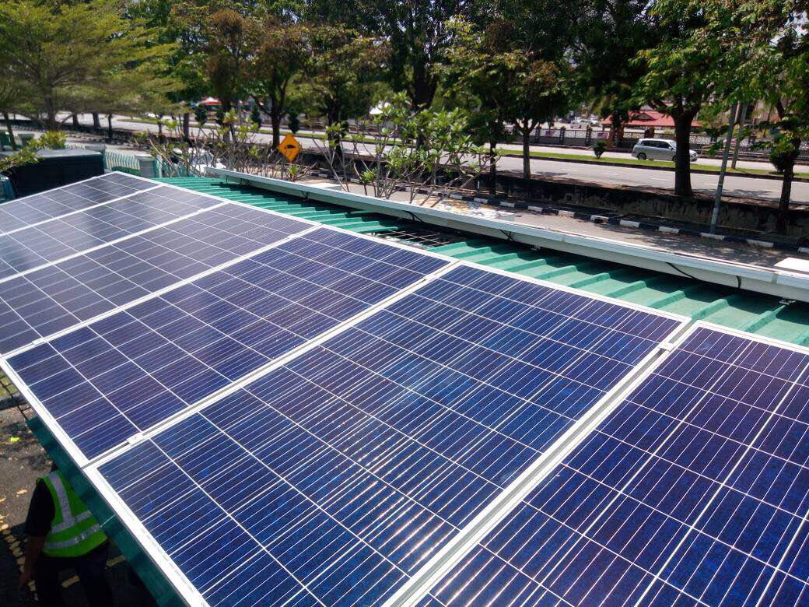
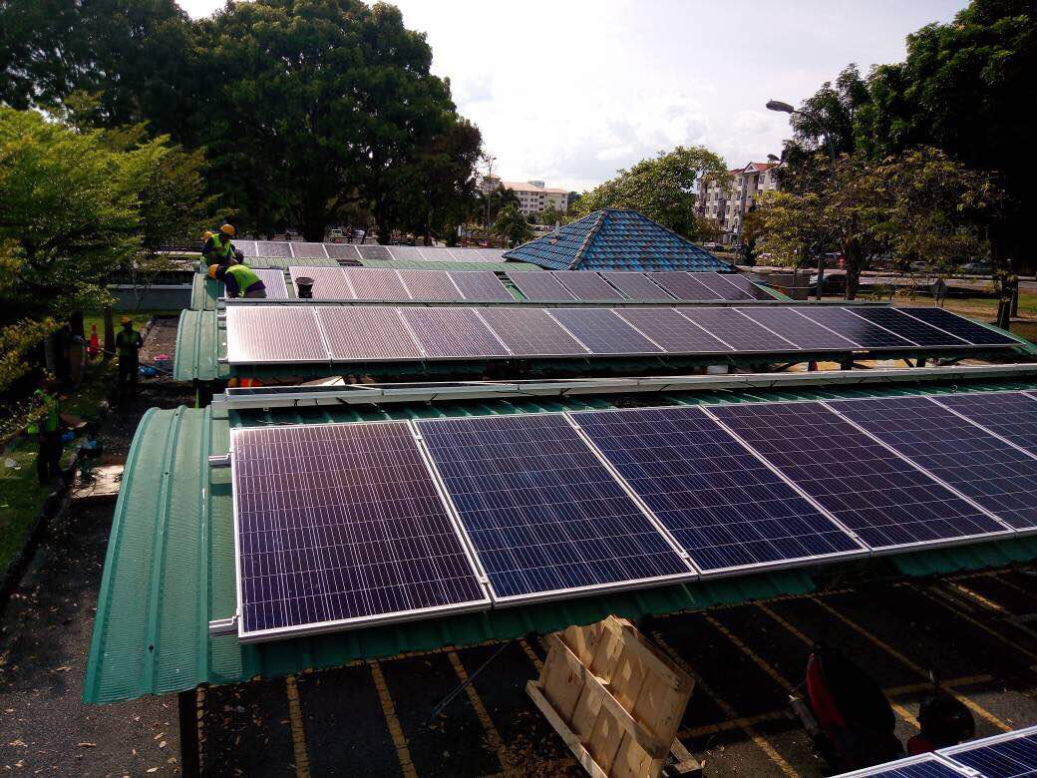
Sustainable Energy
ISO 50001:2011 (EnMS)Energy Management System (15 August 2014).
Fast track incentive was given to planning permission with building design acquire 15% energy from renewable energy and C1- Development order will be issued immediately after approval

Slide 21
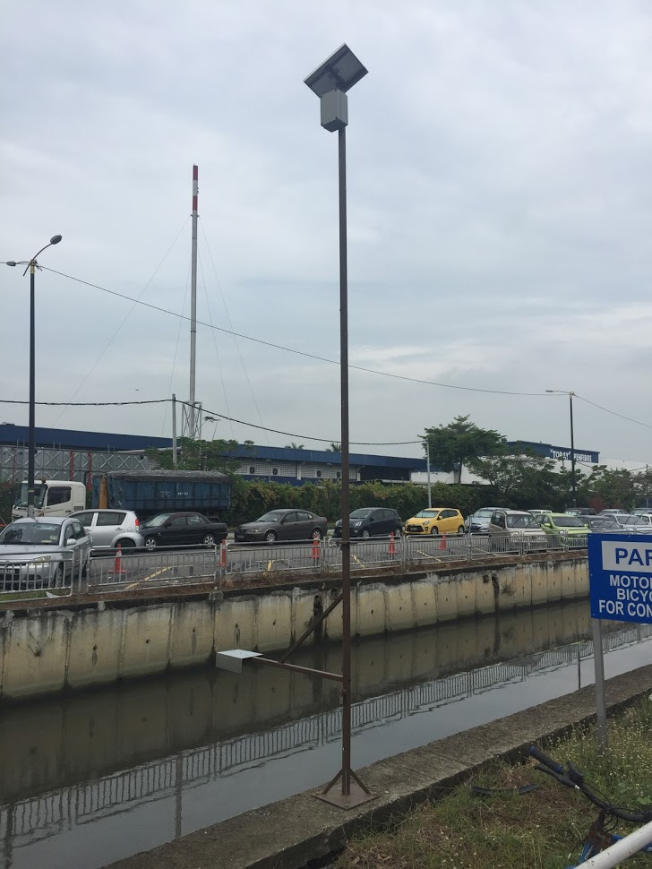
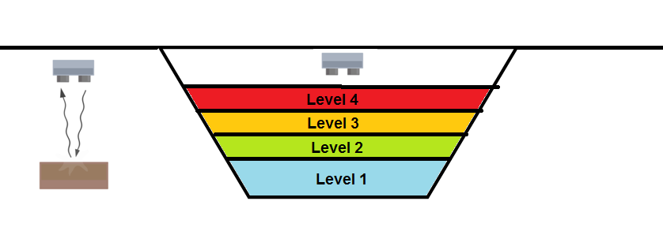
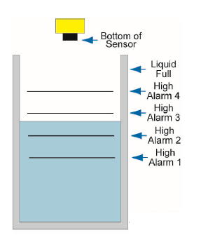
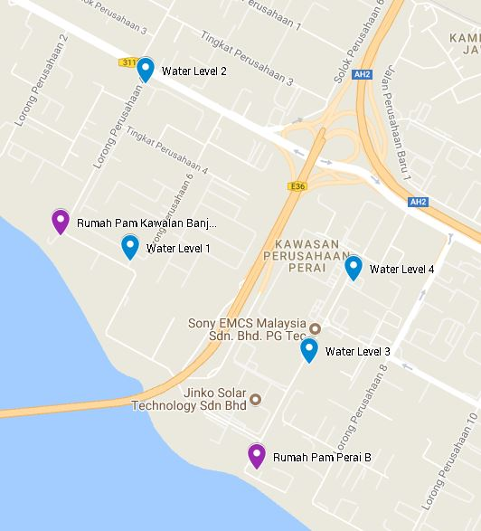
Water Level Monitoring &
Alert Warning System
Remote water lavel monitoring & alert warning system by using IoT technology.
Level 1 – Basic Level
Level 2 – 25% Increase
Level 3 – 50% Increase
Level 4 – 75% Increase
Each level increase, Ultra sonic system will send a notification via SMS, Email or Apps

Slide 22
LED Street Lights
Street Lights High Pressure Sodium Vapour (HPSV) Change To Light Emitted Diode (LED) Under MPSP Jurisdiction
2018- 10,000 Street Lights
LED
HSPV

Slide 23
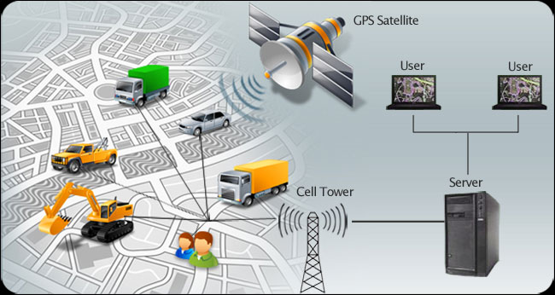
Solid Waste
Management
Big Data Analytic and IoT
Use of GPS to optimize the use of Vehicles.
Use of BDA to calculate and design solid waste projections for
existing development and new developments.
Establish database for solid waste management and recycling.
Loading solid waste data and recycling into the Open Data
MPSP portal

Slide 24
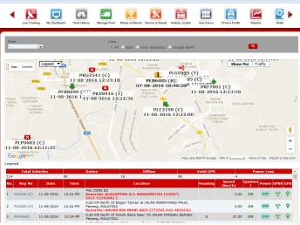
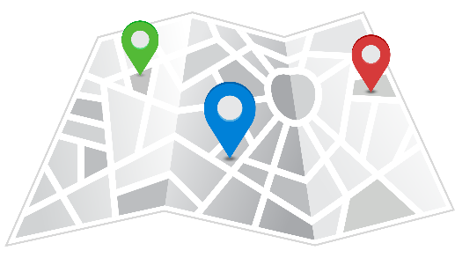
Solid Waste Management
GPS Monitoring
GPS Monitoring
Solid Waste
GPS Tracking
System Analysis
Public Engagement
Education :
Trash2Treasure App (learn how to segregate your waste in a fun way)
Report of
Overflowing Waste

Slide 25
Penang State
Policy
Collaboration with
Smart Partner
No Plastic Bag
No Polystyrenes
Segregation at Source
Penang State Government
Solid Waste has reduced from 1.6kg to 1.3kg
per person per day
3000
- Source by Penang Institute
6
2500
5
2000
4
MPSP
1500
3
1000
2
500
1
0
0
Kg per Household per year
Kg per Household per day
Linear (Kg Household per year)

Slide 26
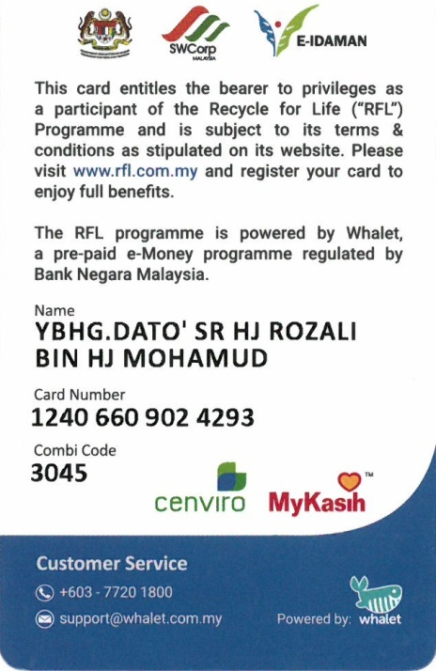
‘ Recycle For Life’
#trashforcash
Launched on 1 Mac 2019 in MPSP-3539 members
Redeem the points at:
Giant Hypermarket
Seri Utama Supermarket
Promart
Top “Ikan Bakar” Restaurant
Tok Keramat Restaurant
MCM Utara Trading
Nice & Clean Car Wash
DXN Café
Classic Finger Hair Cut
Econsave Butterworth
Econsave Summit

Slide 27
RECYLING RATE
YEAR | 2008 | 2009 | 2010 | 2011 | 2012 | 2013 | 2014 | 2015 | 2016 | 2017 | 2018
WASTE (TONNE) | 564,941 | 560,602 | 555,956 | 546,345 | 528,275 | 635,555 | 667,955 | 729,718 | 756,198 | 798,364 | 902,631
RECYCLING (TONNE) | 124,121 (21.97%) | 132,039 (23.55%) | 129,804 (23.3%) | 144,682 (26.48%) | 157,286 (29.77%) | 207,849 (32.7%) | 233,790 (35%) | 289,258 (39.64%) | 322,189 (42.60%) | 345,329 (43.25%) | 425,640 (47.15%)
Seberang Perai has achieved the highest recycling rate in Malaysia at 47.15% in 2018, an increase of 3.9% from 2017.
Seberang Perai target 70% recycling rate and 50% reduction in waste generation by 2022.
Greenhouse gas (GHG) emission is reduced from 8.0 tonnes CO2e per capita to 4.65 tonnes CO2e per capita by 2022.

Slide 28
Financial Performance
Year | Income | Expenditure | Surplus / Deficit
2016 | 237,702.624 | 261,891,710 | (24,189,086)
2017 | 262,901,778 | 279,933,623 | (17,031,845)
2018 | 300,124,004 | 286,931,878 | 13,192,126

Slide 29
Penang Sentral
An integrated urban TOD (trans-oriented development) being built on 22.65 acres of land and divided into eight (8) phases.
A transportation hub, comprising an integrated terminal for all buses, rail and sea transportation services within Penang. Scheduled to be completed by 2030.
The first phase of the Penang Sentral project completed and opened on 22 November 2018.
The Gross Development Value (GDV) for the overall project which includes a number of components estimated to be valued at RM2.9 billion. It will attract tourist from Thailand, Medan and within the country.

Slide 30
What can the GCoM offer to support the inclusive
climate action initiative?
The Global Covenant of Mayors for Climate and Energy is an International Alliance of cities and local governments with a shared long-term vision of promoting and supporting voluntary action to combat climate change and move to a low emission, resilient society.
GCoM will help in facilitating :
1) Capacity Building for our partner cities by Coordinating experts into the city.
2) Developing Climate Action Plan for Partner Cities that need helps.
3) Create Networking between Partner Cities.
4) Sharing Best Practices among Partner Cities.
5) Helping in improving the Bankability of Cities Projects.
6) Match Making with Financial Institution to Fund Climate Action
Projects.

Slide 31
How cities can become part of the global movement to address climate change?
Climate Change is serious Issue that need to be address fast. City play a major roles in reducing the impact of Climate Change as Cities are the front liner that deal with stakeholders. Thus, City cannot act by itself, by joining The Global Covenant of Mayors for Climate and Energy (GCoM), City will be able to understand and share practices on the mechanisms that can be done by the city in reducing the impact. This Coalitions will have a shared long-term vision of promoting and supporting voluntary action to combat climate change and move to a low emission, resilient society. City to City best practices sharing are imperative to address climate change.
“

Slide 32
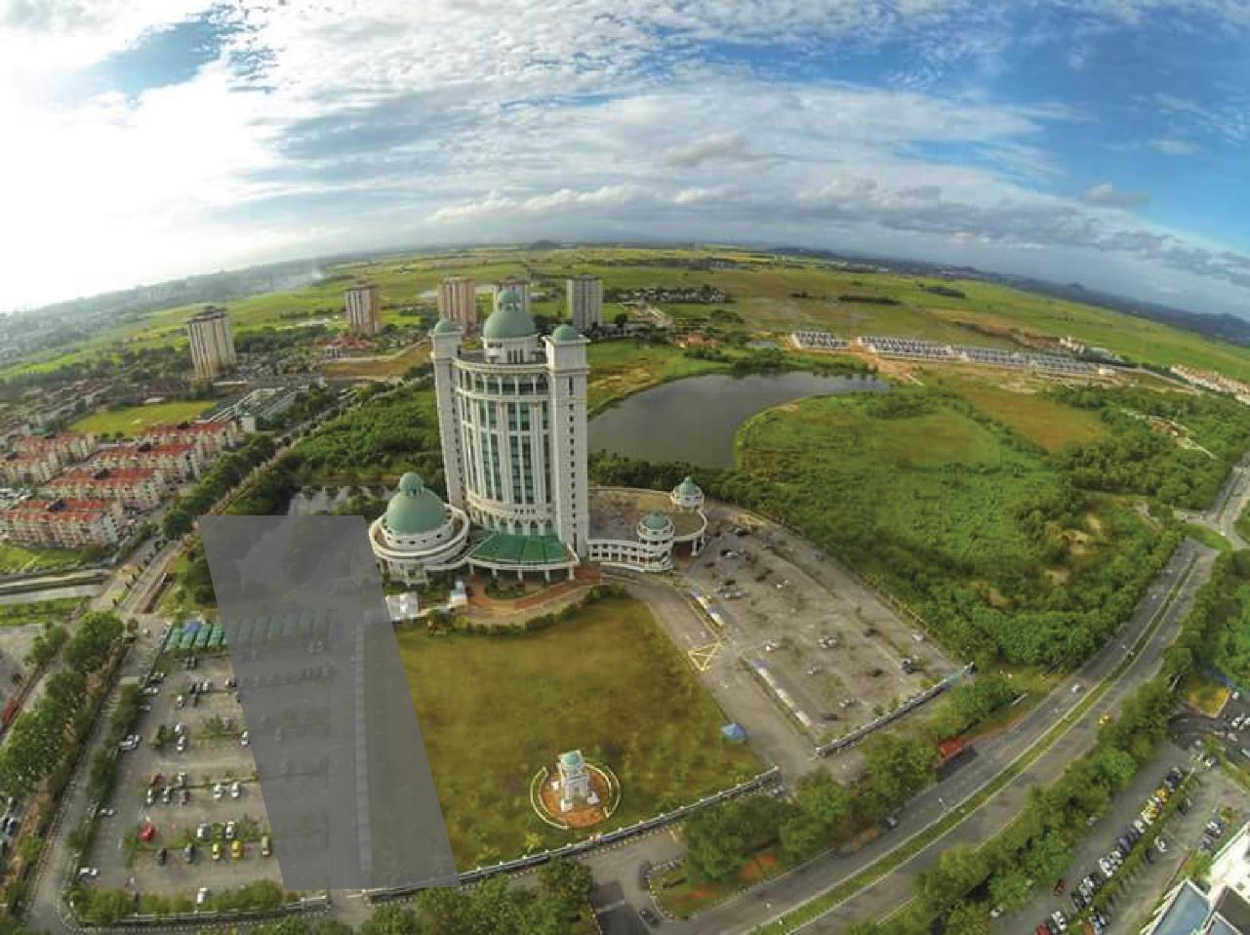
Thank You
#myseberangperai
MAJLIS PERBANDARAN SEBERANG PERAI
SEBERANG PERAI MUNICIPAL COUNCIL
Jalan Perda Utama
Bandar Perda
14000, Bukit Mertajam
Penang, Malaysia
Tel : +604 – 5497 700
Tel : 1 – 800 – 88 – 6777 (Free Toll)
Fax : +604 – 5395 588
Web : http://www.mpsp.gov.my

